Slide 1

Machine Learning and Artificial Intelligence
By
Dr. Nilay Karade
Academic Program Manager
Notes:
1

Slide 2
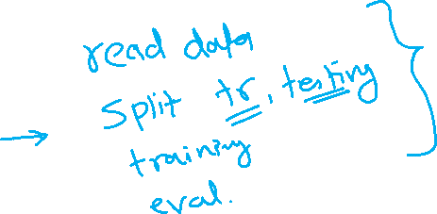
Machine Learning and Artificial Intelligence
Million 10^6
Billion 10^9
Trillion 10^12
Quadrillion 10^15
Quintillion 10^18
ML model
Theory
Python implementation
ML model building
Training
Evaluating
Tuning
ML models
Regression
Classification
Clustering
Capstone project

Slide 3

Agenda
Million 10^6
Billion 10^9
Trillion 10^12
Quadrillion 10^15
Quintillion 10^18
Introduction to Machine Learning
Types of Machine Learning
Data Science – ML – AI
1st ML model - Linear Regression

Slide 4
Learning
2

Slide 5
Learning
2 2 2 2

Slide 6

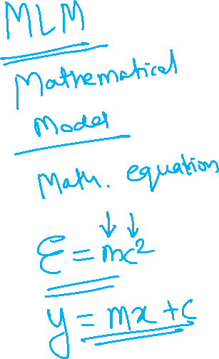
Machine Learning
Notes:
6

Slide 7
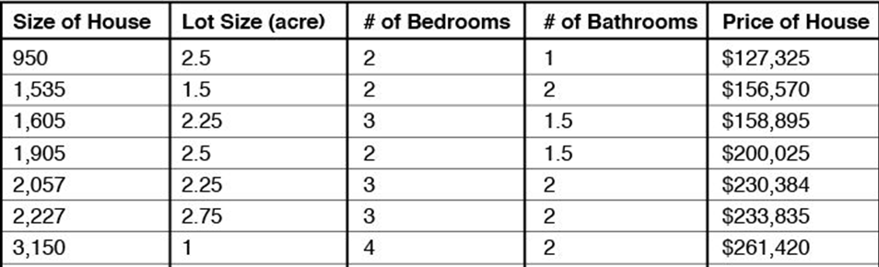
Machine Learning
Independent variables
Dependent var.
+ + + =
* v1 * v2 * v3 * v4

Slide 8



Predictions with ML models
+ + +
* v1 * v2 * v3 * v4

Slide 9

Types of Machine Learning
ML
Supervised Learning
Unsupervised Learning
Reinforcement Learning
Regression
Classification
Customer segmentation
Robot navigation
Price of a home
Is email spam or not?

Slide 10
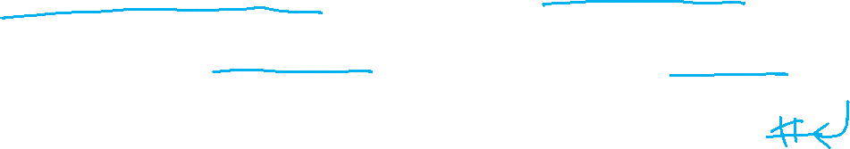
Supervised Learning - Regression
Independent variables
Dependent var.

Slide 11

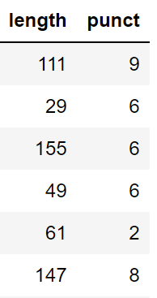
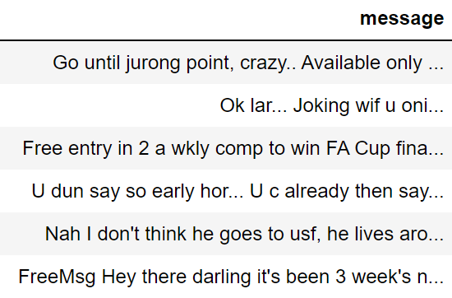


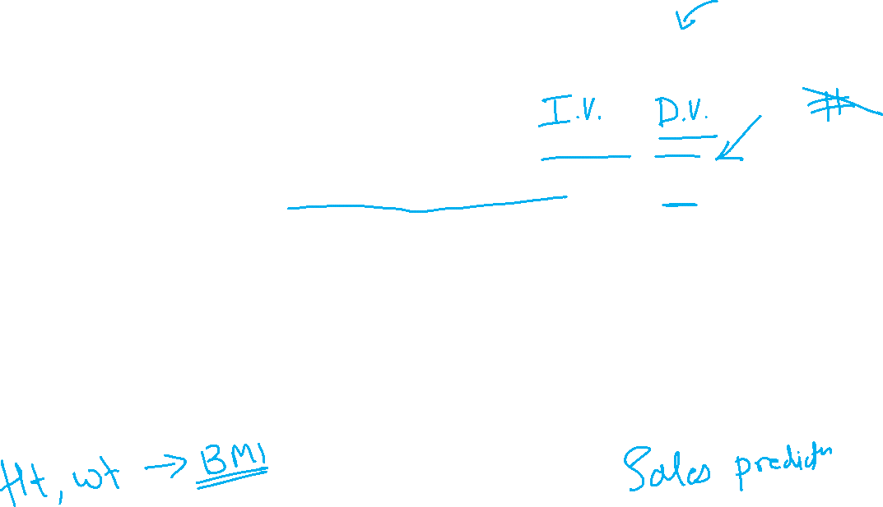
Supervised Learning - Classification

Slide 12

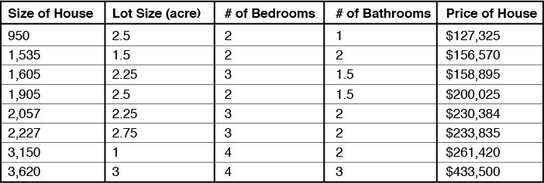


Unsupervised Learning - Clustering

Slide 13

Unsupervised Learning - Clustering
Independent variables
Dependent var.
Predictions
Apartment
Apartment
Apartment
Apartment
Small house
Small house
Villa
Villa

Slide 14

Reinforcement Learning – Robotic Automation

Slide 15
AI / ML / DL / DS
Artificial Intelligence
Machine Learning
Data
Science
Deep
Learning
Notes:
15

Slide 16
Quick Recap
Million 10^6
Billion 10^9
Trillion 10^12
Quadrillion 10^15
Quintillion 10^18
Machine Learning
Regression
Classification
Clustering
DS-AI-ML-DL

Slide 17

Shopping apples from mall
Quantity | Calculate price | Parking fee | Price
1 | 10 * 1 = 10 | 20 | 30
2 | 10 * 2 = 20 | 20 | 40
3 | 10 * 3 = 30 | 20 | 50
… | … | … | …
10 | 10 * 10 = 100 | 20 | 120
…. | … | … | …
x | 10 * x = 10x | 20 | y
y = 10x + 20
y = mx + c

Slide 18
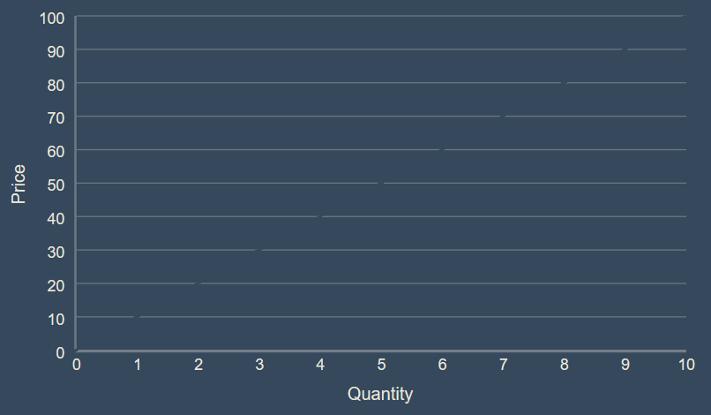
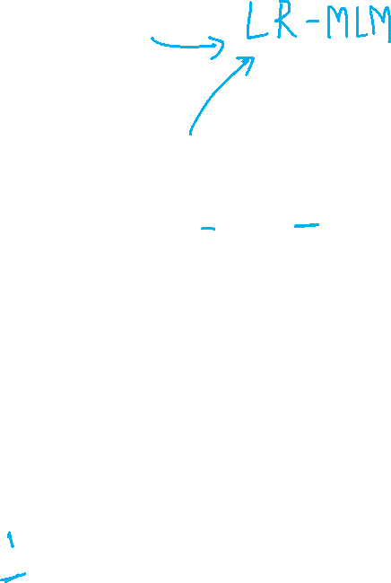
y = 10x + 20
y = 10*6 + 20 = 80
y = 10*4 + 20 = 60
Quantity of apples
Multiply it with 10
And add 20
You get the price
y = 10*3 + 20 = 50
Notes:
18

Slide 19

y = 10x + 20
(6,80)
y = mx + c
dy
= 80 -60 = 20
(4,60)
dx
= 6 – 4 = 2
m = dy / dx
m = 20 / 2
= 10
c = 20

Slide 20
Quick Recap
Million 10^6
Billion 10^9
Trillion 10^12
Quadrillion 10^15
Quintillion 10^18
Line of equation
Intercept c
Slope m

Slide 21
Predicting salary of an employee using Linear Regression
Years of Experience | Salary
1.1 | 39343
1.3 | 46205
1.5 | 37731
2 | 43525
2.2 | 39891
2.9 | 56642
3 | 60150
3.2 | 54445
3.2 | 64445
3.7 | 57189
3.9 | 63218
4 | 55794
4 | 56957
4.1 | 57081
4.5 | 61111
4.9 | 67938
5.1 | 66029
5.3 | 83088
5.9 | 81363
6 | 93940
6.8 | 91738
7.1 | 98273
7.9 | 101302
8.2 | 113812
8.7 | 109431
9 | 105582
9.5 | 116969
9.6 | 112635
10.3 | 122391
10.5 | 121872
Independent variable (x)
Dependent variable (y)

Slide 22
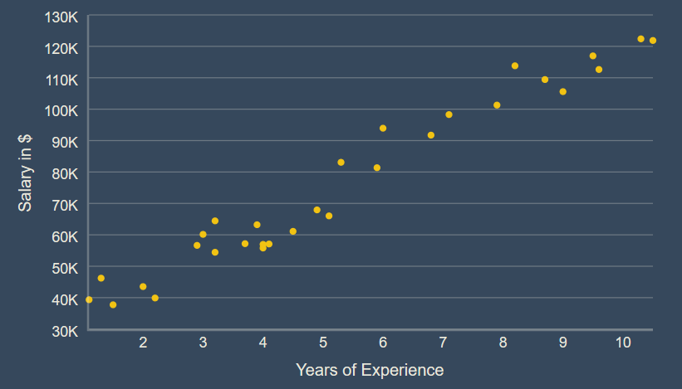

Slide 23
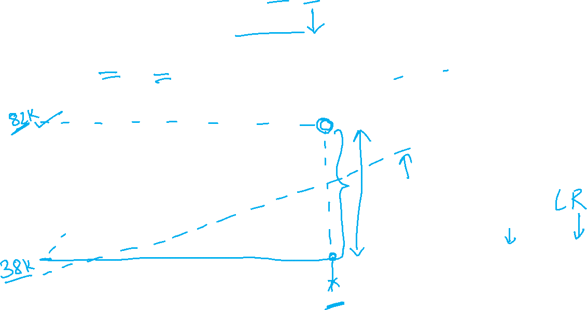
E = E1 + E2 + E3 + … + En
E = ∑Ei
En
y = mx + c
Changing values of m and c
Notes:
23

Slide 24
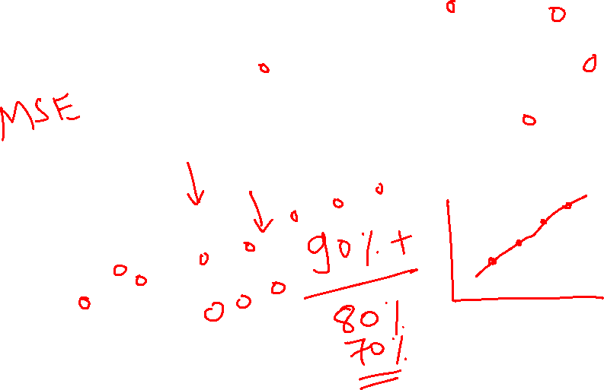
y = mx + c

Slide 25
En
E10
E = E1 + E2 + E3 + … + En
E = ∑Ei
E1
E2

Slide 27
Quick Recap
Million 10^6
Billion 10^9
Trillion 10^12
Quadrillion 10^15
Quintillion 10^18
Line of equation
Intercept c
Slope m
Total error in prediction
E = E1 + E2 + E3 + … + En
E = ∑Ei
Predicted value ŷ_{i} and actual value y_{i}

Slide 28
Training &Testing Dataset
X
y
Yrs. Experience | Salary

Slide 29
Training &Testing Dataset
X_train
10
15
18
33
.
.
.
y_train
10M $
15M $
18M $
33M $
.
.
.
X
10
12
15
18
20
.
.
.
33
y
10M $
12M $
15M $
18M $
20M $
.
.
.
33M $
y_test
12M $
20M $
X_test
12
20

Slide 30
Training &Testing Dataset
X_test
12
20
y_pred
12.5M $
21.2M $
y_test
12M $
20M $

